Slide 1
A Survey on IoT Based Smart City
Israt Jahan Joya (160239)
A. K. M. Fahim Rahman (160215)

Slide 2
At a Glance
What is IoT?
What is Smart City?
Abstract
Proposed Techniques
Future Work
Conclusion

Slide 3
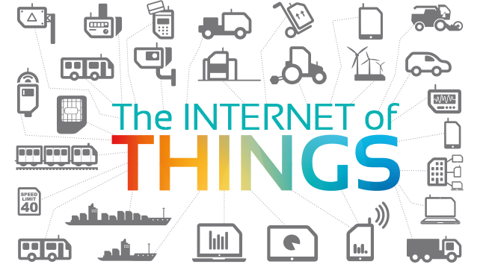
What is IoT?

Slide 4
What is IoT? (cont..)
The Internet of Things (IoT) is a system of interrelated computing devices, mechanical and digital machines, objects, animals or people that are provided with unique identifiers and the ability to transfer data over a network without requiring human-to-human or human-to-computer interaction.
The Internet of Things (IoT) is a novel paradigm that is rapidly gaining ground in the scenario of modern wireless telecommunications.

Slide 5

What is Smart City?

Slide 6
What is Smart City? (Cont..)
A smart city is an urban area that uses different types of electronics data collection sensors to supply information which is used to manage assets and resources efficiently.

Slide 7
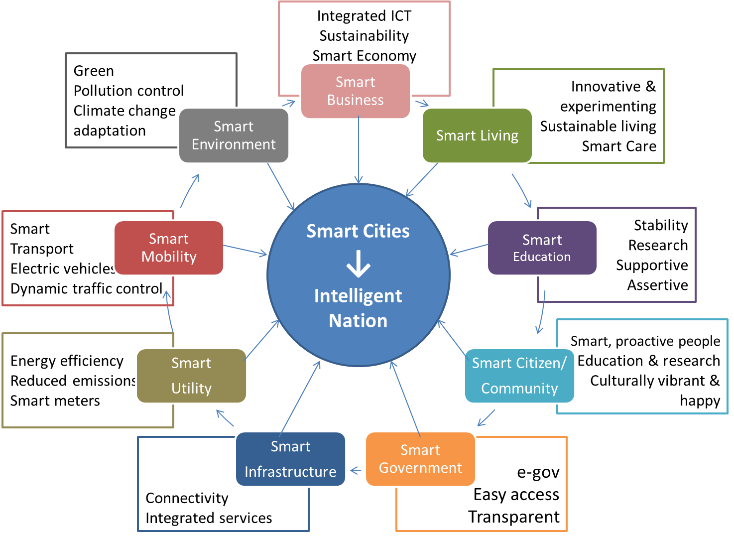
What is Smart City? (cont..)

Slide 8
Abstract
Although a smart city consists of many paradigm like smart parking, smart healthcare, smart electricity, smart waste management etc.
In our paper we have surveyed one of the three problem “pollution problem”, “Electricity Loss problem” and “Waste Management” of a smart city.
ATmega16A is used to control the electricity loss and observe the pollution level.
ZigBee is used to maintain the waste bin monitoring
MQ135 is used to detect the harmful gases.
Sound Sensor is used to detect the sound pollution.

Slide 9
Proposed Techniques
ATmega16A
ZigBee
Sound Sensor
MQ135
ESP8266

Slide 10
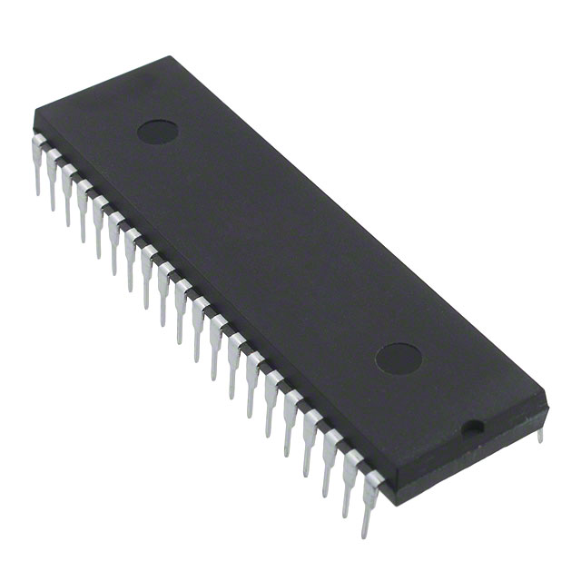
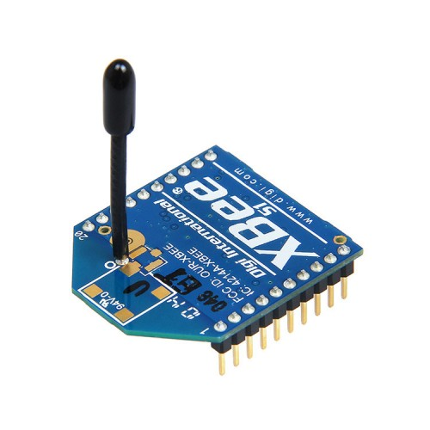
Proposed Techniques

Slide 11
ATmega16A
It has high-performance.
Low-power consumption.
8-bit Microcontroller.
It is fully Static Operation.
512Bytes EEPROM.
Real Time Counter with Separate Oscillator

Slide 12
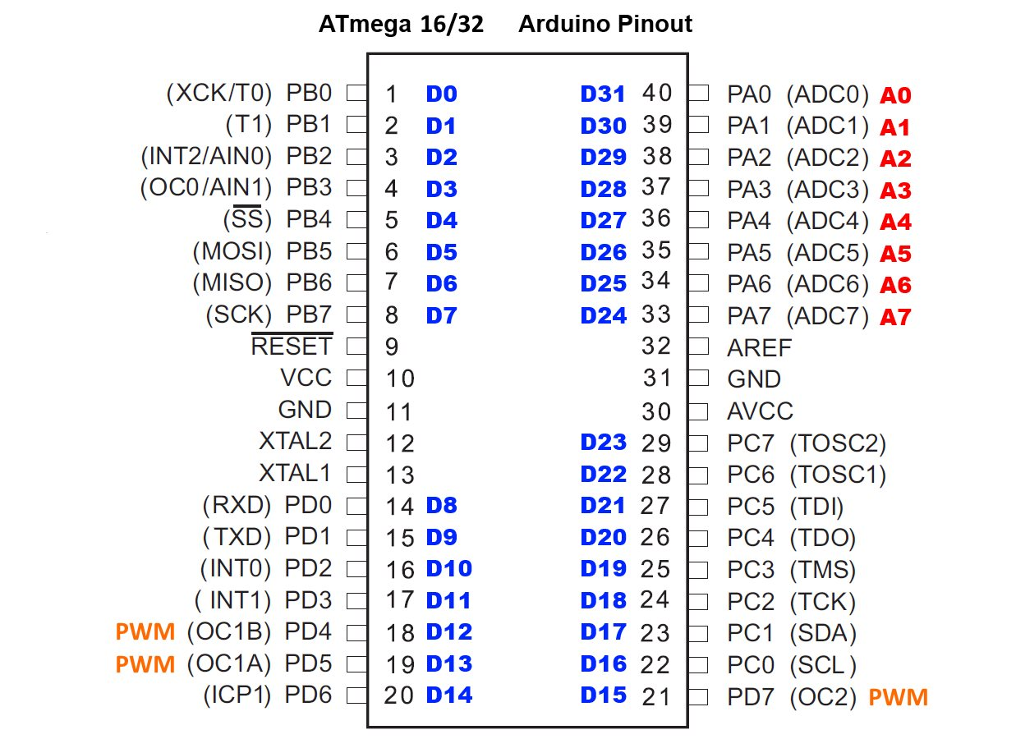
ATmega16A (cont..)

Slide 13
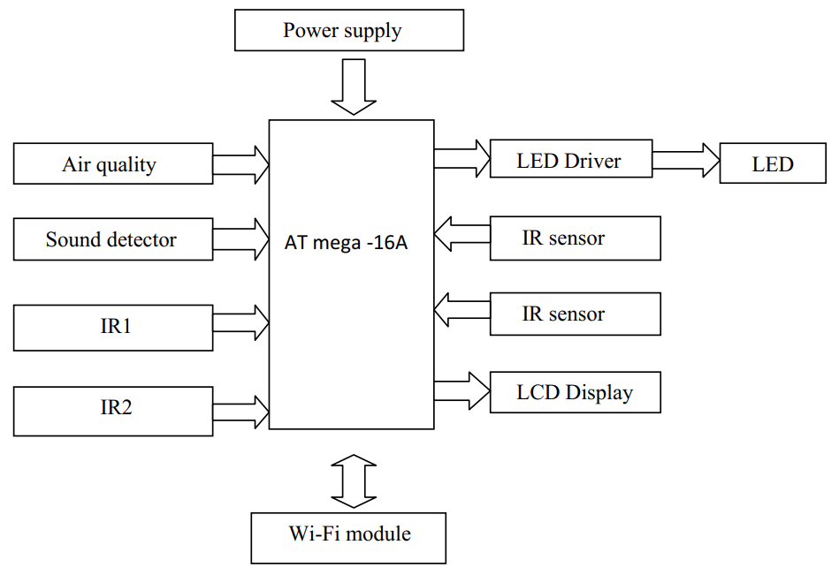
ATmega16A (cont..)

Slide 14
Electricity Loss Controlled
ATmega16A is a 8-bit microcontroller.
ATmega16A is used to controlled the electricity loss in smart city.
Takes inputs as IR, gas sensor, sound sensor and process it.
Then it sends data to the CPU.
Thus it helps to detect the gas level and sound pollution level and maintain the electricity loss problem.
It consume very low power as a result electricity loss problem can be maintained.

Slide 15
ZigBee
Low battery consumption.
Low cost.
Low data rate. The maximum data rate for a ZigBee device is 250Kbps.
ZigBee can automatically establish its network.
ZigBee uses small packets compared with Wi-Fi and Bluetooth.
Memory 100KB

Slide 16
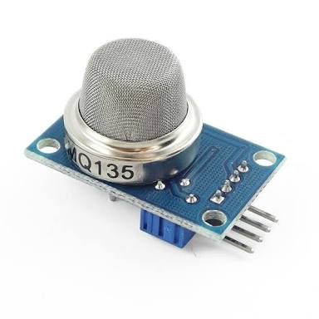
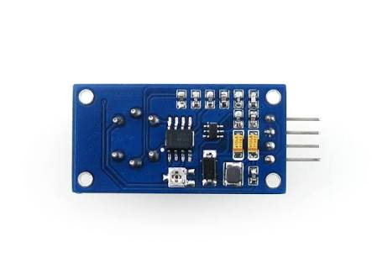
MQ135
Fig: MQ135 Gas Sensor

Slide 17
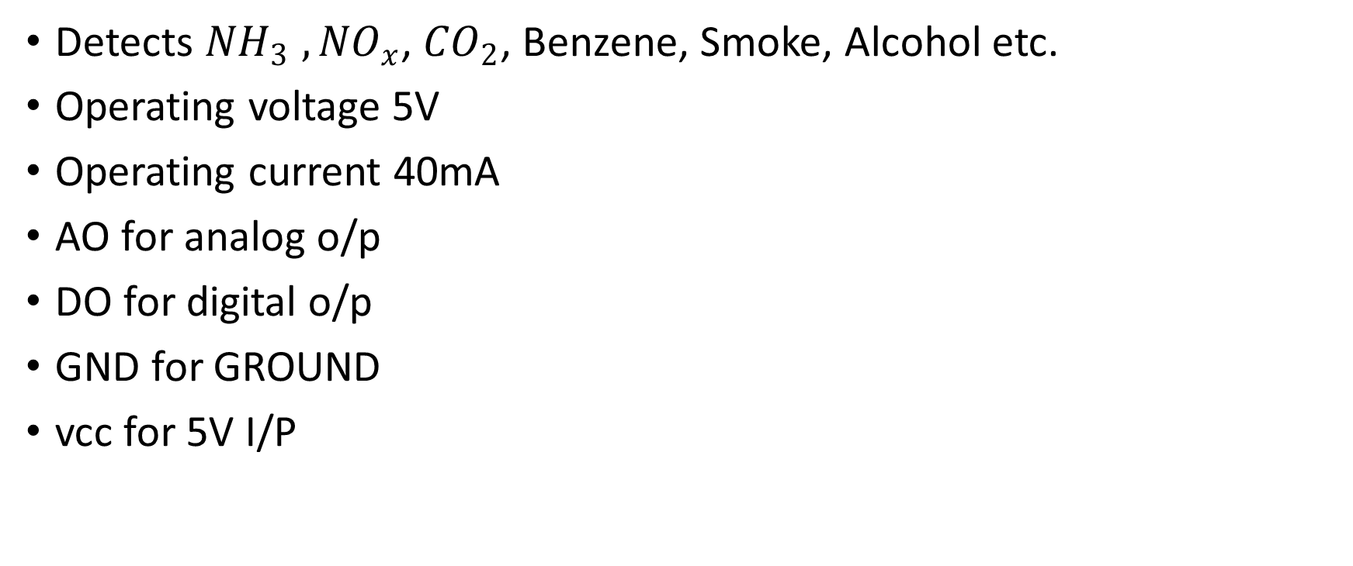
MQ135 (cont..)
Detects ${NH}_{3} ,{NO}_{x}$, ${CO}_{2}$, Benzene, Smoke, Alcohol etc.
Operating voltage 5V
Operating current 40mA
AO for analog o/p
DO for digital o/p
GND for GROUND
vcc for 5V I/P

Slide 18
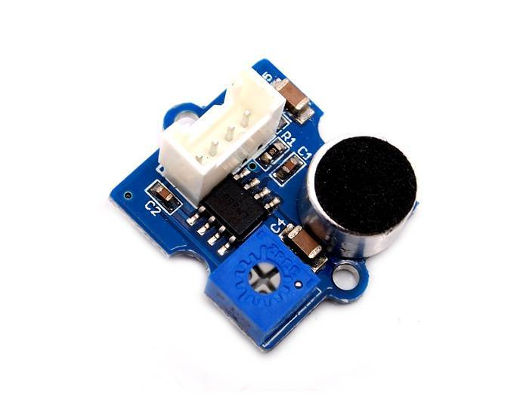
Sound Sensor

Slide 19
Future Work
Although ATmega16A is comparatively very good device but its data rate is very low.
Use Low level language as result programmer have to go through documentation.
ZigBee network is not secure like Wi-Fi network.
Replacement cost is high when any problem occurs.
ZigBee coverage is limited.

Slide 20
Conclusion
The Smart city mission will drive economic growth and improve the quality of life of people and enable development of local areas.
It will help connect technology which will lead to smart outcomes.
The Automatic Air and Sound management system is a step forward to provide a answer to the biggest threat.

Slide 21
Conclusion (cont..)
It supports the new technology and effectively supports the healthy life concept.
We also feel the necessity of future research towards ecofriendly, cost friendly and green smart city.
---------

Slide 22
Thank You

